Slide 1
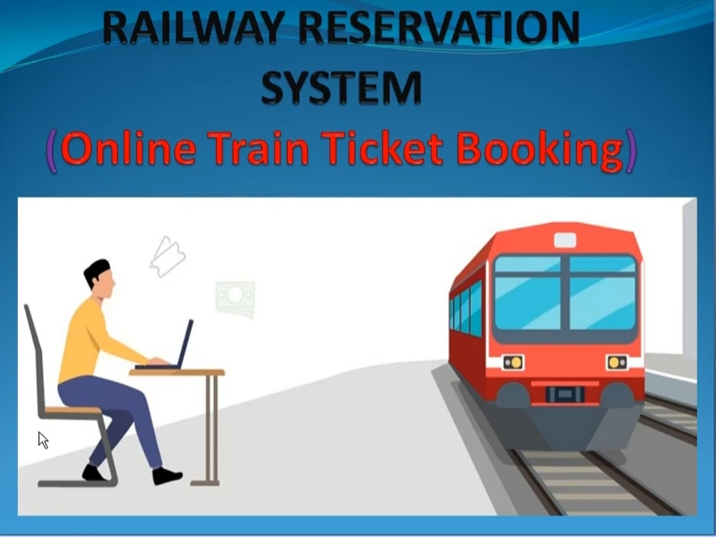

Slide 2
ASSAM ENGINEERING COLLEGE
Guided By :
Riju Kalita
Presented By :
Sirujjal Borah (18/375)
Abishek Gupta (18/366)

Slide 3
INTRODUCTION
The Indian Railways (IR) carries about 5.5 lakhs passengers in reserved accommodation every day.
The Computerised Passenger Reservation System (PRS) facilitates the booking and cancellation of tickets from any of the 4000 terminals (i.e. PRS booking window all over the countries). These tickets can be booked or cancelled for journeys commencing in any part of India and ending in any other part, with travel time as long as 72 hours and distance up to several thousand kilometers.
In our project, we will be developing a website which will help users to find train details, book and cancel tickets and the exact rates of their tickets to the desired destination.
With the help of online booking people can book their tickets online through internet, sitting in their home by a single click of mouse. Using their credit cards people can easily get their tickets done within minutes

Slide 4
PROPOSED SYSTEM
To keep pace with time, to bring about the best result without malfunctioning
and greater efficiency so to replace the unending heaps of flies with a much
sophisticated hard disk of the computer; we have to use the data management software.
Our website has various kinds of information that helps regarding booking of tickets via railways . Users will be able to search the train availability , the exact fare ,the arrival and departure time of the train and they can also book the ticket by using the debit ,credit or master car

Slide 5
OBJECTIVE
The objective of the online railway ticket reservation system Project is to design software to fully automate the process of issuing a railway ticket.
That is:- 1. To create a database of the trains
2. To search the trains it’s arrival and departure time,distance between source and destination.
3.To check the availability of the ticket.
4. To calculate fare.
5.To book the ticket.
6.To cancel the ticket if necessary.

Slide 6
ABSTRACT
“Railway Reservation” is the system where the users can reserve the railway seats. Designed a Railway ticket booking, reservation, and cancellation system for users that wish to travel via the Railways.

Slide 7
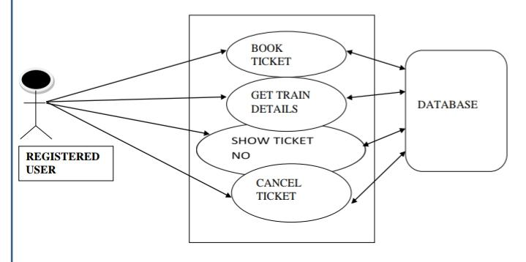
Detailed design specification:

Slide 8
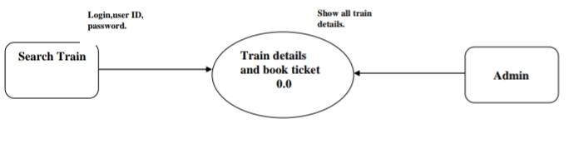
Data Flow Diagram
Level 0 DFD

Slide 9
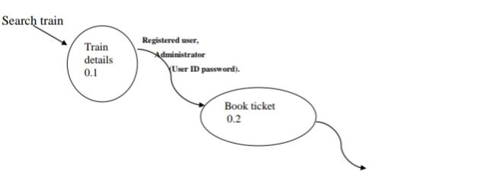
Data Flow Diagram
Level 1 DFD

Slide 10
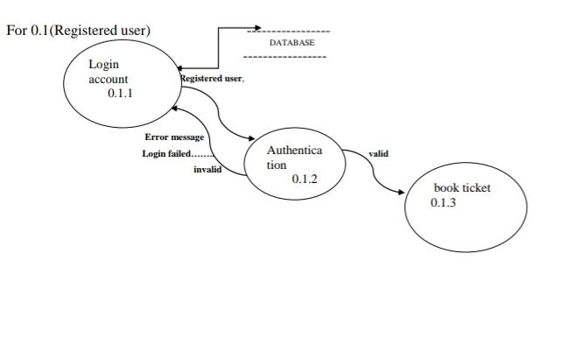
Data Flow Diagram
Level 2 DFD

Slide 11
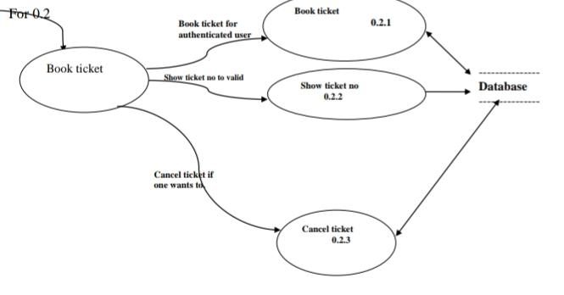
Data Flow Diagram
Level 3 DFD

Slide 12
FEATURES
Registration
Password
Login and logout
Search train

Slide 13
FEATURES
Booking
Cancellation
Check pnr status
Change Password

Slide 14
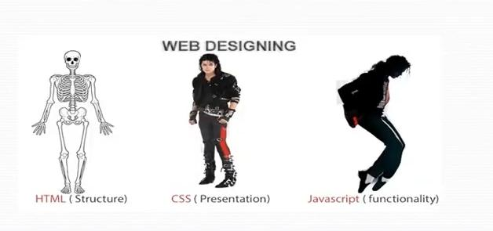
THE TECHNOLOGIES USED IN THIS PROJECT ARE :
HTML (HYPERTEXT MARKUP LANGUAGE)
CSS (CASCADING STYLE SHEET)
BOOTSTRAP (FRAMEWORK OF CSS AND JS)

Slide 15

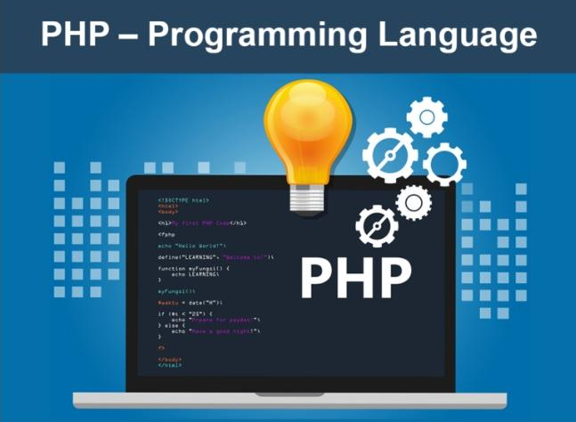
THE TECHNOLOGIES USED IN THIS PROJECT ARE :
JS: Frontend
PHP: Backend

Slide 16
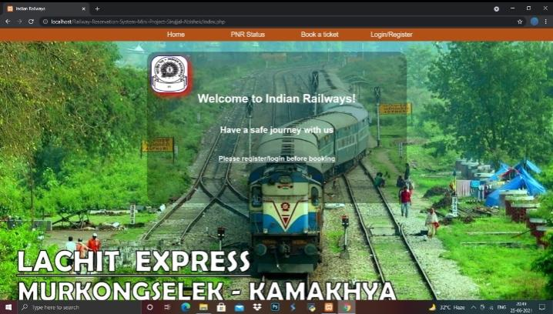
HOME PAGE

Slide 17
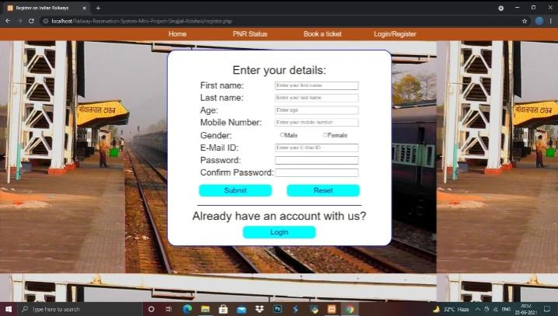
USER REGISTRATION PAGE

Slide 18
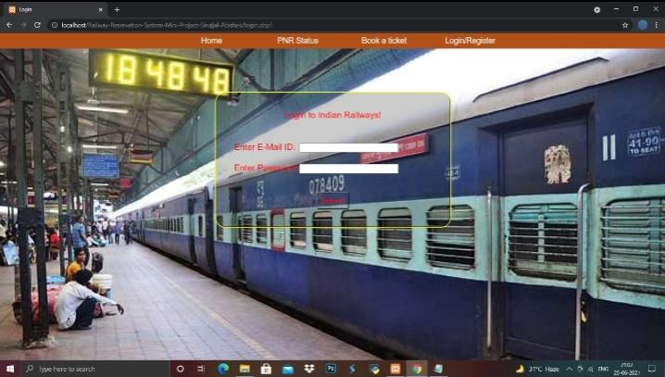
USER LOGIN PAGE

Slide 19
CONCLUSION AND FUTURE SCOPE
FUTURE SCOPE: This web application involves almost all the features of the online train ticket booking. The future implementation will be online help for the customers and chatting with website administrator.
CONCLUSION: The project entitled "Online Train Ticket Booking" is developed using HTMI, CSS and Bootstrap and JS as front end and PHP and MySQL database in back end to computerize the process of online railway ticket booking. This project covers only the basic features required.

Slide 20
BIBLIOGRAPHY
www.w3schools.com
https://youtu.be/F65zrW7Jbus
https://youtu.be/7QC9pQXdlMc
https://medium.com/@sapphdek/learn-how-to-build-a-website-using-html-css-php-mysql-af385524a5d6
https://www.udemy.com/course/learn-web-development-php-mysql-html-css-bootstrap-oop/

